Slide 1
Diamond Price Prediction
Team 1

Slide 2
CONTENTS
Introduction
EDA
Data preprocessing
Checking data for outliers
fit model
Evaluate

Slide 3
Steps
1
2
3
4
5
Step 1
Step 2
Step 3
Step 4
Step 5
Import Needed Libraries
Data preprocessing and Dealing With Outlier
Create Model
Load & Summary Data
Visualization

Slide 4
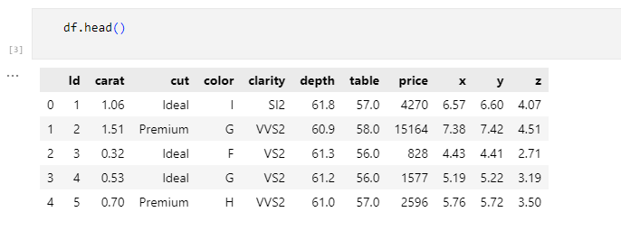
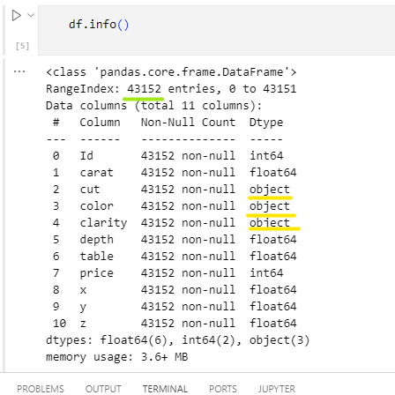
Head & Info

Slide 5
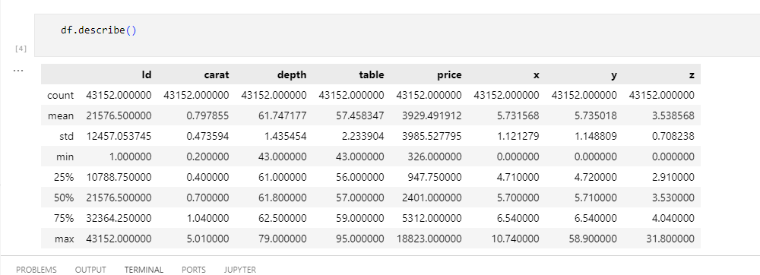
Describe

Slide 6
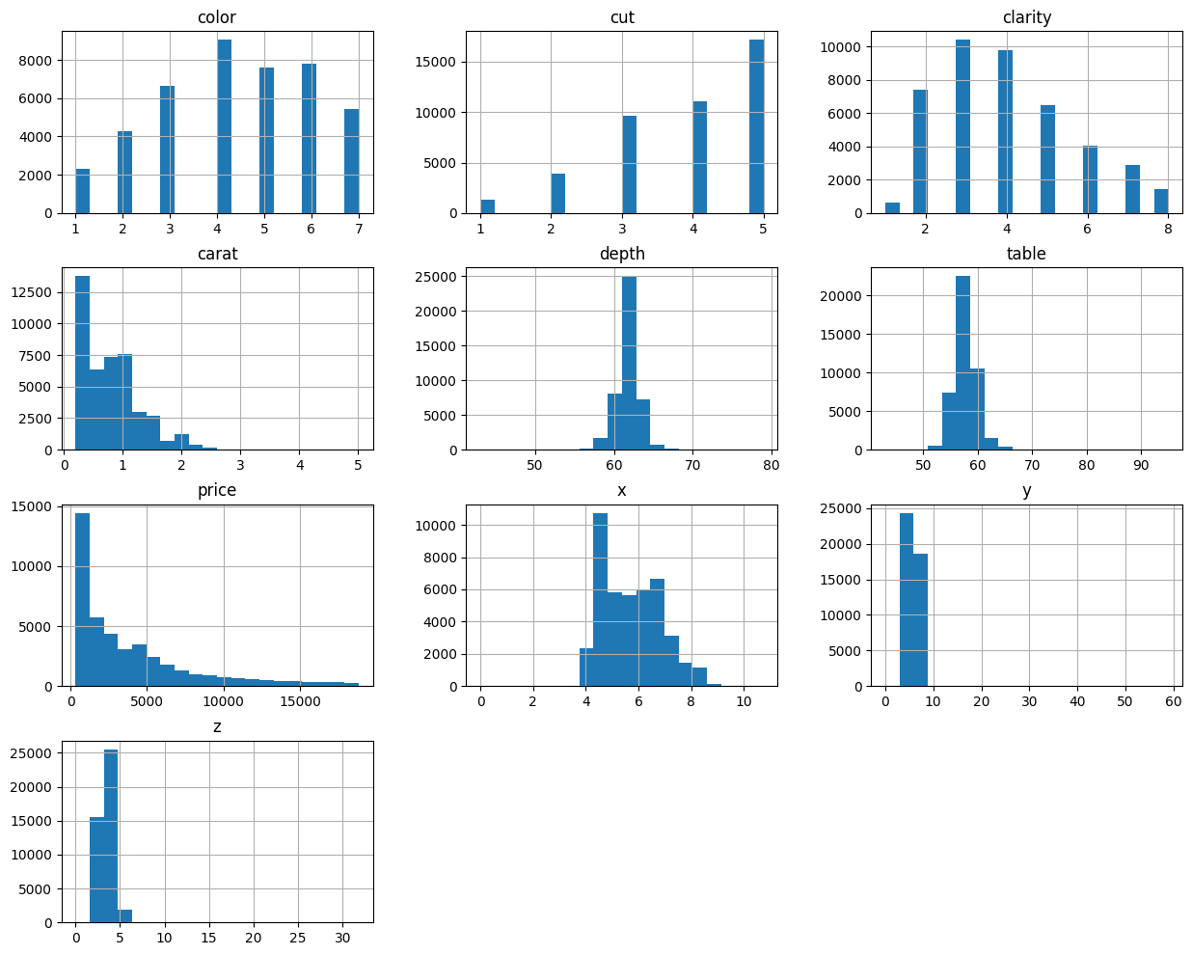
Draw histograms for each variable

Slide 7
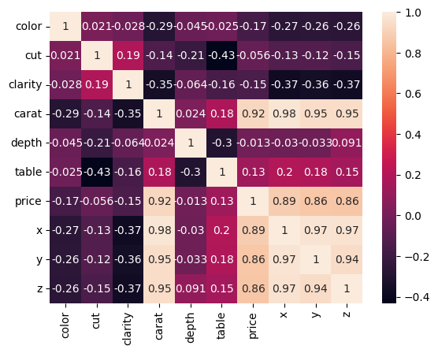
HeatMap

Slide 8

Data preprocessing
We will delete the duplicate data, and we will delete the lines that contain zeros in x, y, and z , and we will fill the remaining values for z using the depth equation.

Slide 9
Dealing With Category
We know that if there is a category feature, we encode it. There are many types of encoding, some of which are one-hot encoding, and ordinal encoding. Here we found that the three features (color, cut, clarity) are category features with an order from worst to best, so we used ordinal encoding, which It replaces each category with an appropriate ordinal number indicating the category's ranking in the categories of the same column

Slide 10
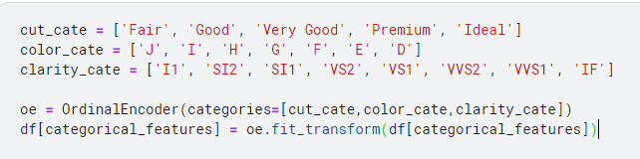
OrdinalEnconder :

Slide 11
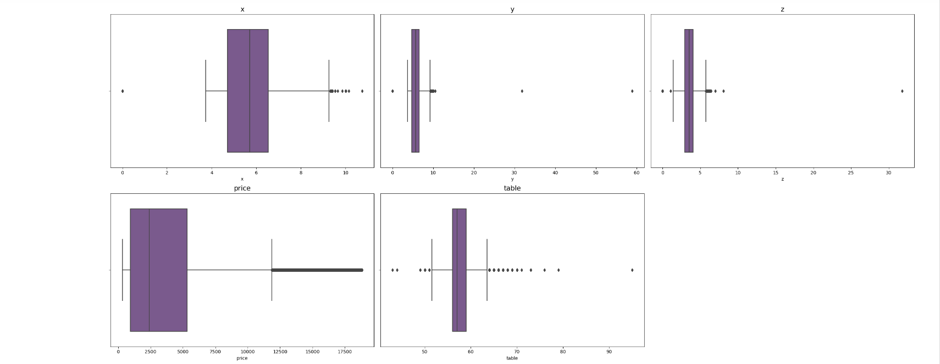
outliers in data

Slide 12
The ways to detect outliers
Using Z score
Using IQR

Slide 13
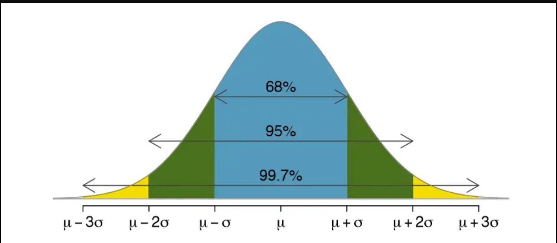
Using Z score
It is better way if data is normal distributed

Slide 14
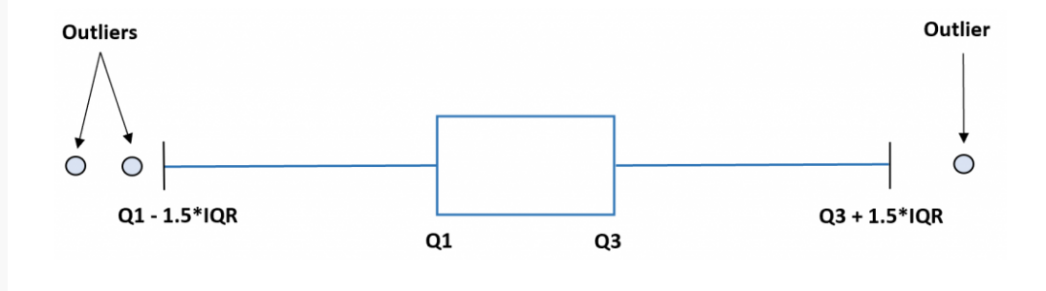
Using IQR

Slide 15
Evaluation
How did We select the best model ?
How did We improve the score ?
Used Polynomial Feature with degree 5
Feature Selection - Used chi2
We scored 508 on the Kaggle
Compared regression models using cross-validation (RMSE)
We then selected the top 3 performing models.
We then applied various feature engineering techniques to the data and evaluated each on Kaggle.
We scored 534 on the Kaggle

Slide 16
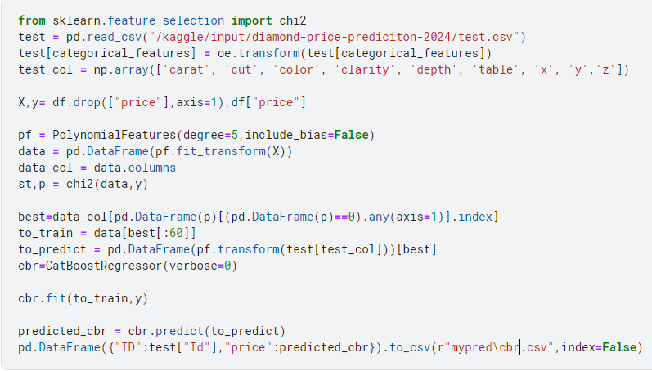
THE CODE

Slide 17
MEET OUR TEAM
Abd Alrhman Qarah-Bolad
Ahmad Abu Ghazaleh
Safa Abouzaid
Mena Adel

Slide 18
THANK YOU

